Slide 1
Of Whom We Hold Dear
Group 1
-Matthew Allum
-Aaron Mulligan
- Lee Hatchman
Notes:
Aaron: 4, 5, 6, 7, 11
Matt: 1, 2, 3, 10
Lee: 8, 9,

Slide 2
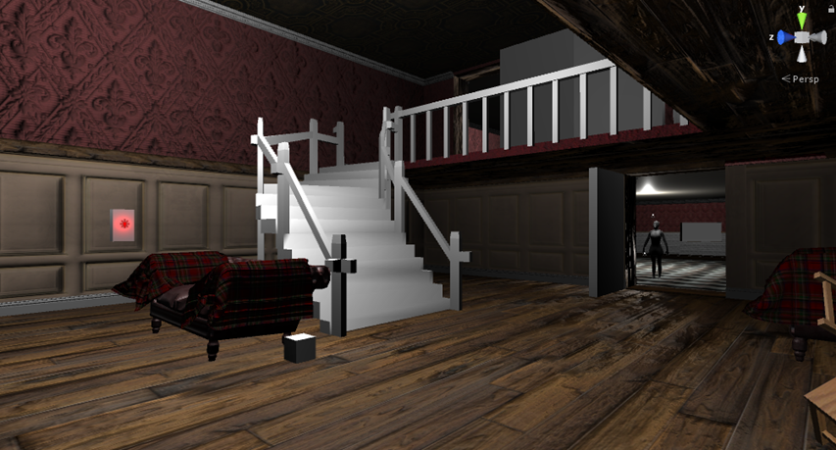
Audience/Logline
Take control and experience an ageing MC struggling with anterograde amnesia. Help him discover what he’s lost and find the truth behind his accident.
PC platform – First person perspective
Teens/young adult males & females
Notes:
Audience/Logline
We will need to discuss who the character will be (example: Gender, age, anything about them unless we’re making it so the player is the character)
Sporadic productivity, will need to have a definition of what it means for the audience for them to have an understanding of what it means.
Could maybe turn the beginning of the logline into a rhetorical question, example: “Ever wonder what really happens to that one person who holds up a game lobby?”
Following it up with: “Come find out by playing as [character] who suffers from sporadic productivity who must complete menial tasks at the expense of others”

Slide 3
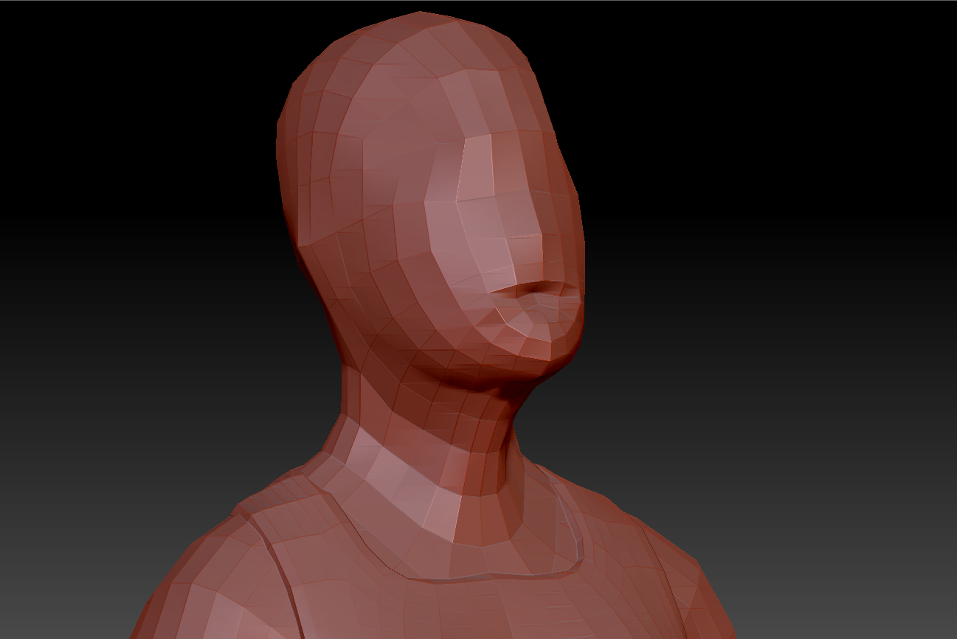
Gameplay

Slide 4
Tranzfuser Project
Applied for Tranzfuser Project
4 man team – 4th member will be Junior
Main focus now is to create playable, two staged demo

Slide 5
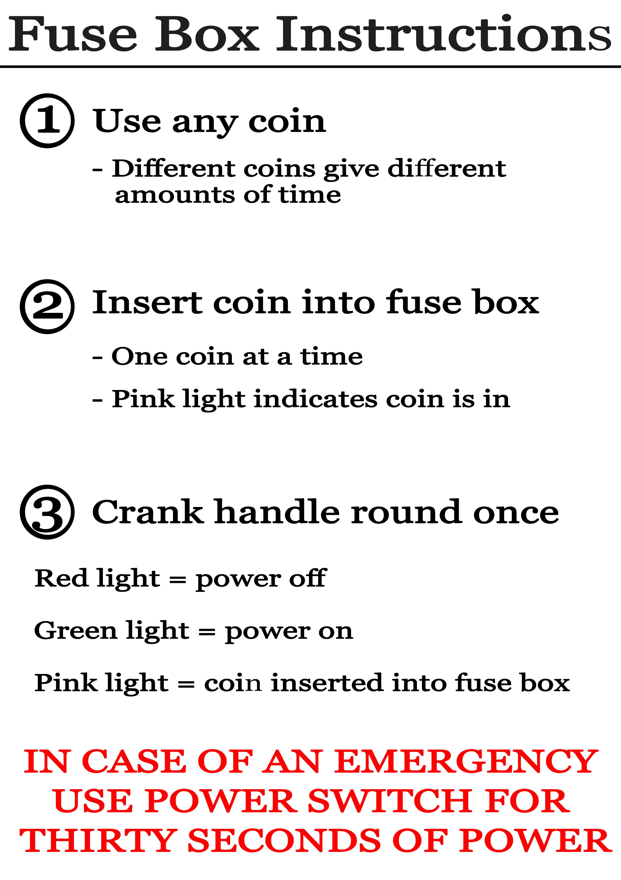
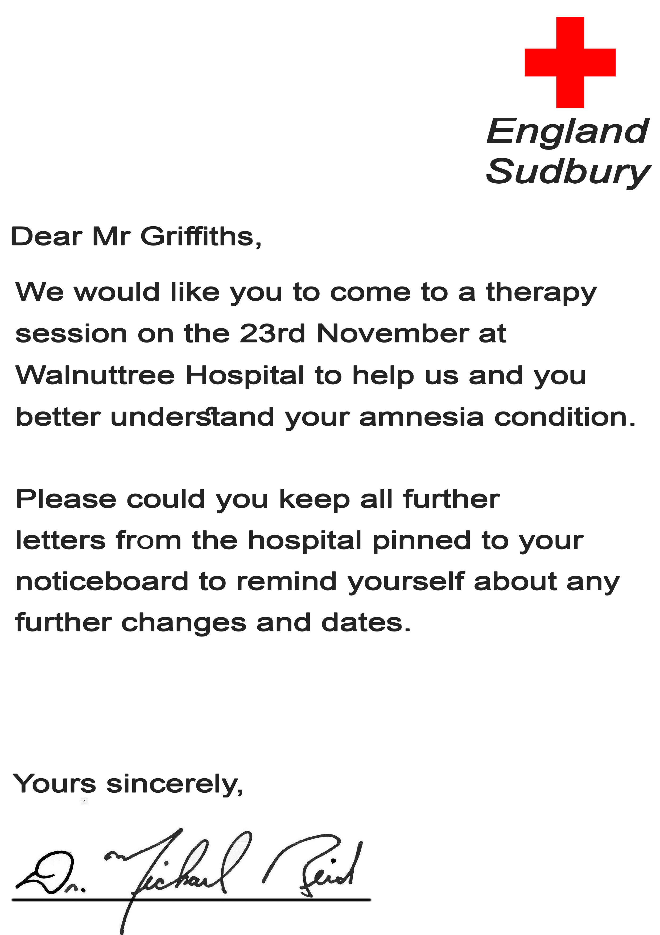
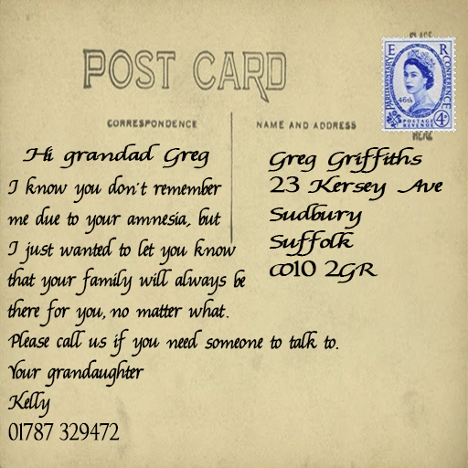
Noticeboard Notes
Instructions Doctors notes Family letters Sticky Notes

Slide 6
Animations
Mixamo 3D Animation Service
Used for carer walk animation

Slide 7
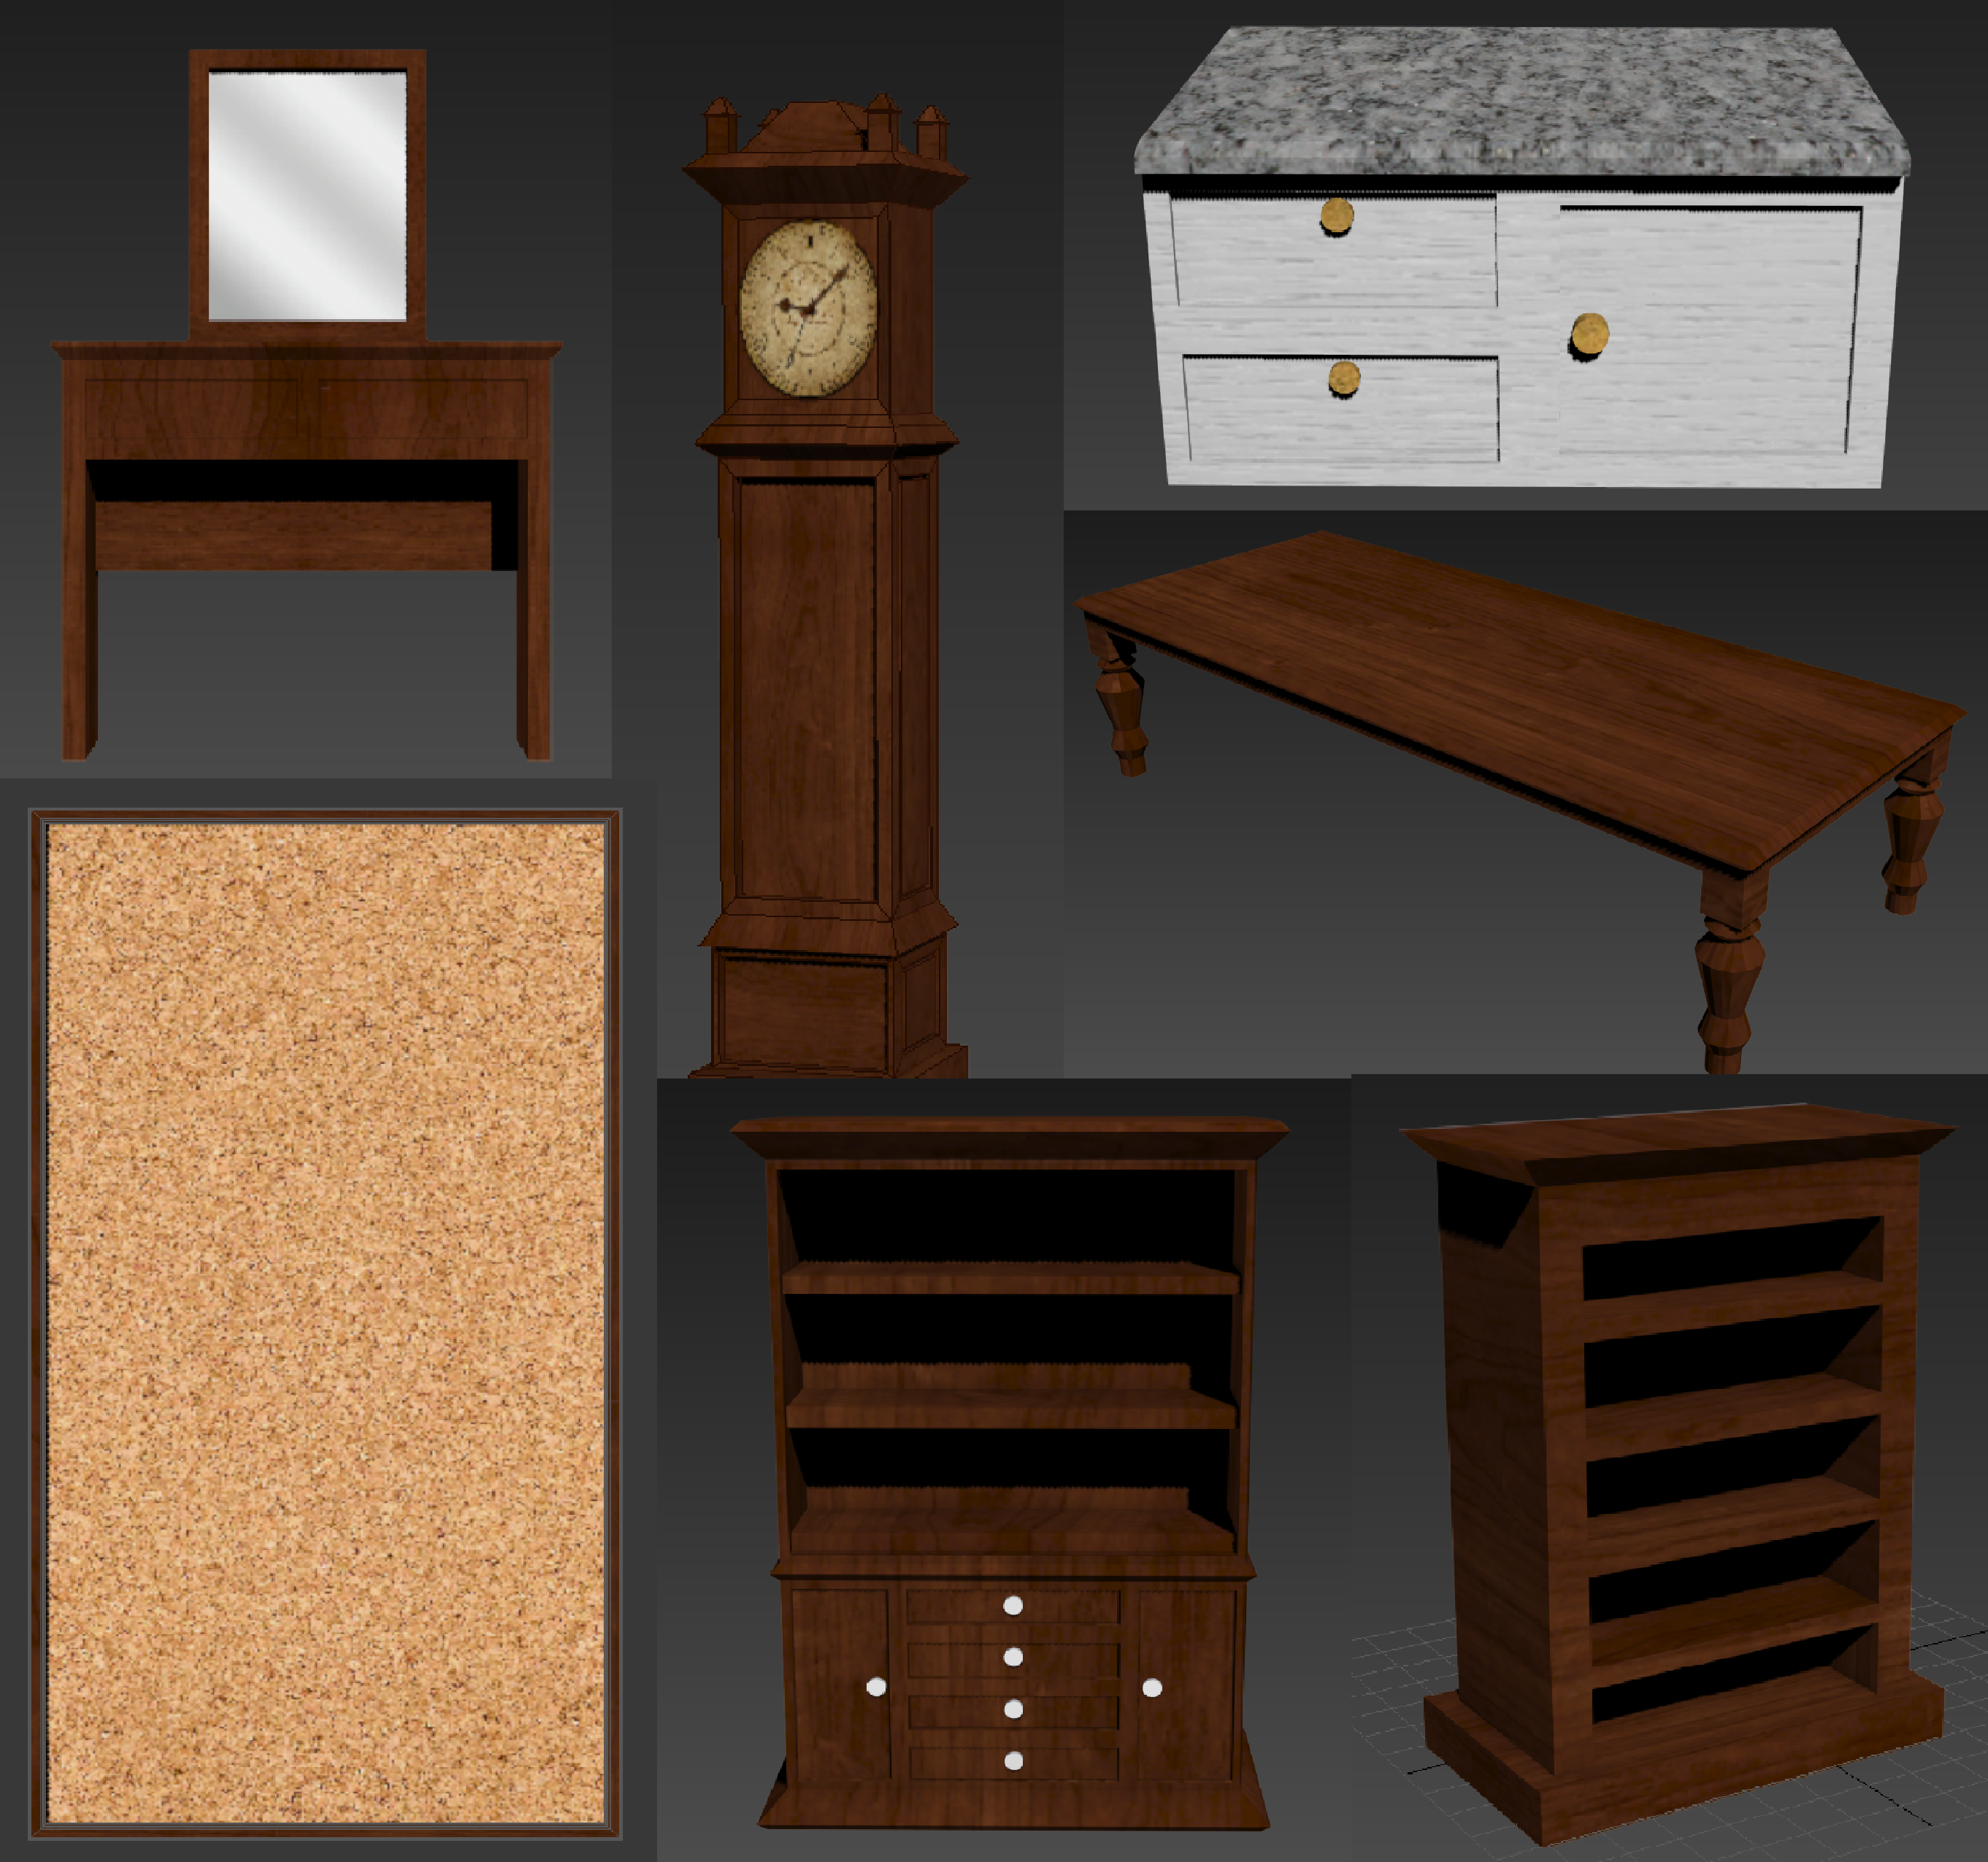
Models

Slide 8
Future tasks
Populating all available rooms with models
Sounds (actions, ambience)
Workable, playable demo for playtesting

Slide 9
Questions?

